Slide 1
CMPE 331
WindowBuilder

Slide 2
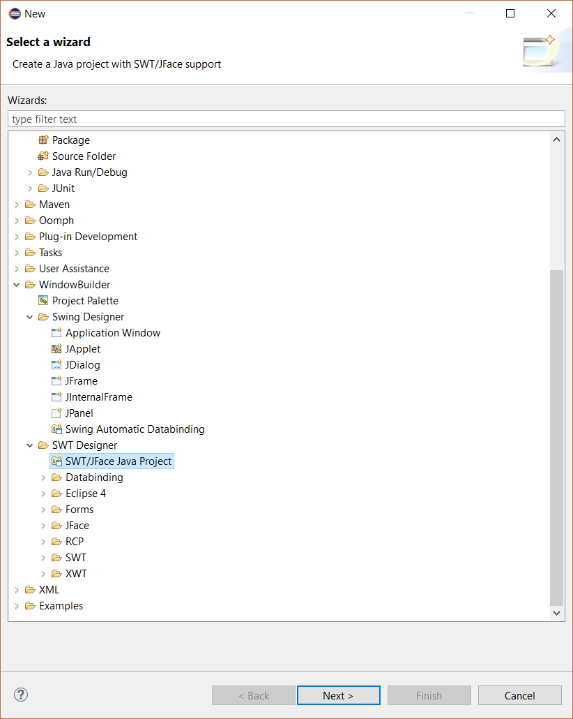
How to steps
Choose:
New -> Other WindowBuilder -> SWT/ Jface Java Project

Slide 3
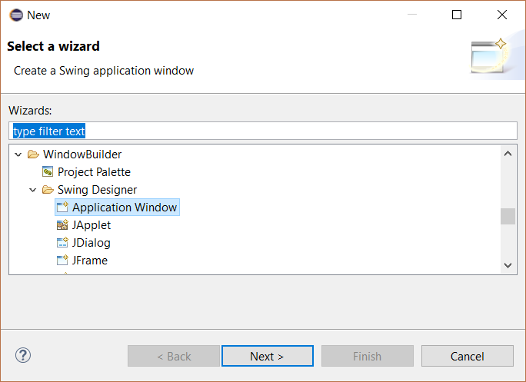
Steps
Choose:
New -> Application Window in the project you have created.

Slide 4
Steps -Tips
You can drag and drop items on the «Design» view.
You can code on the «Source» view.

Slide 5
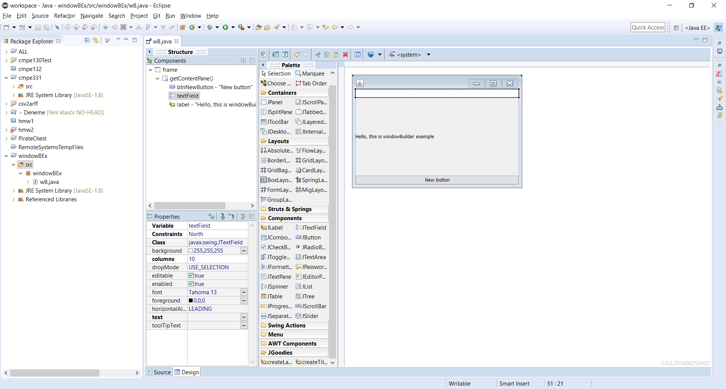
Source View Let’s us code
Design View Let’s us see the changes

Slide 6
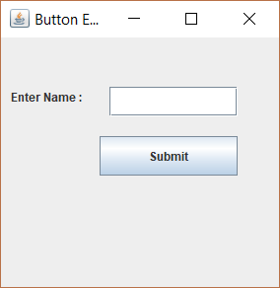
Try to code this example

Slide 7
